Slide 1


Strategies to Advance Carbon Capture
March 15, 2018
Jeff Erikson

Slide 2
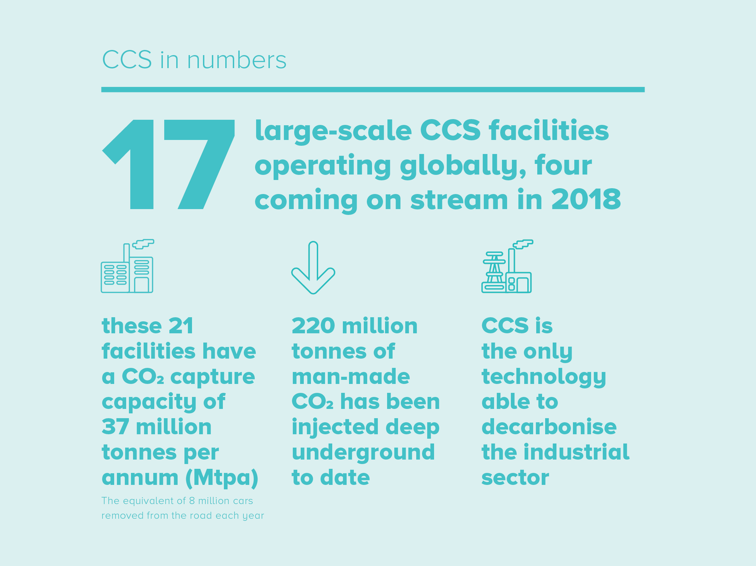

Slide 3
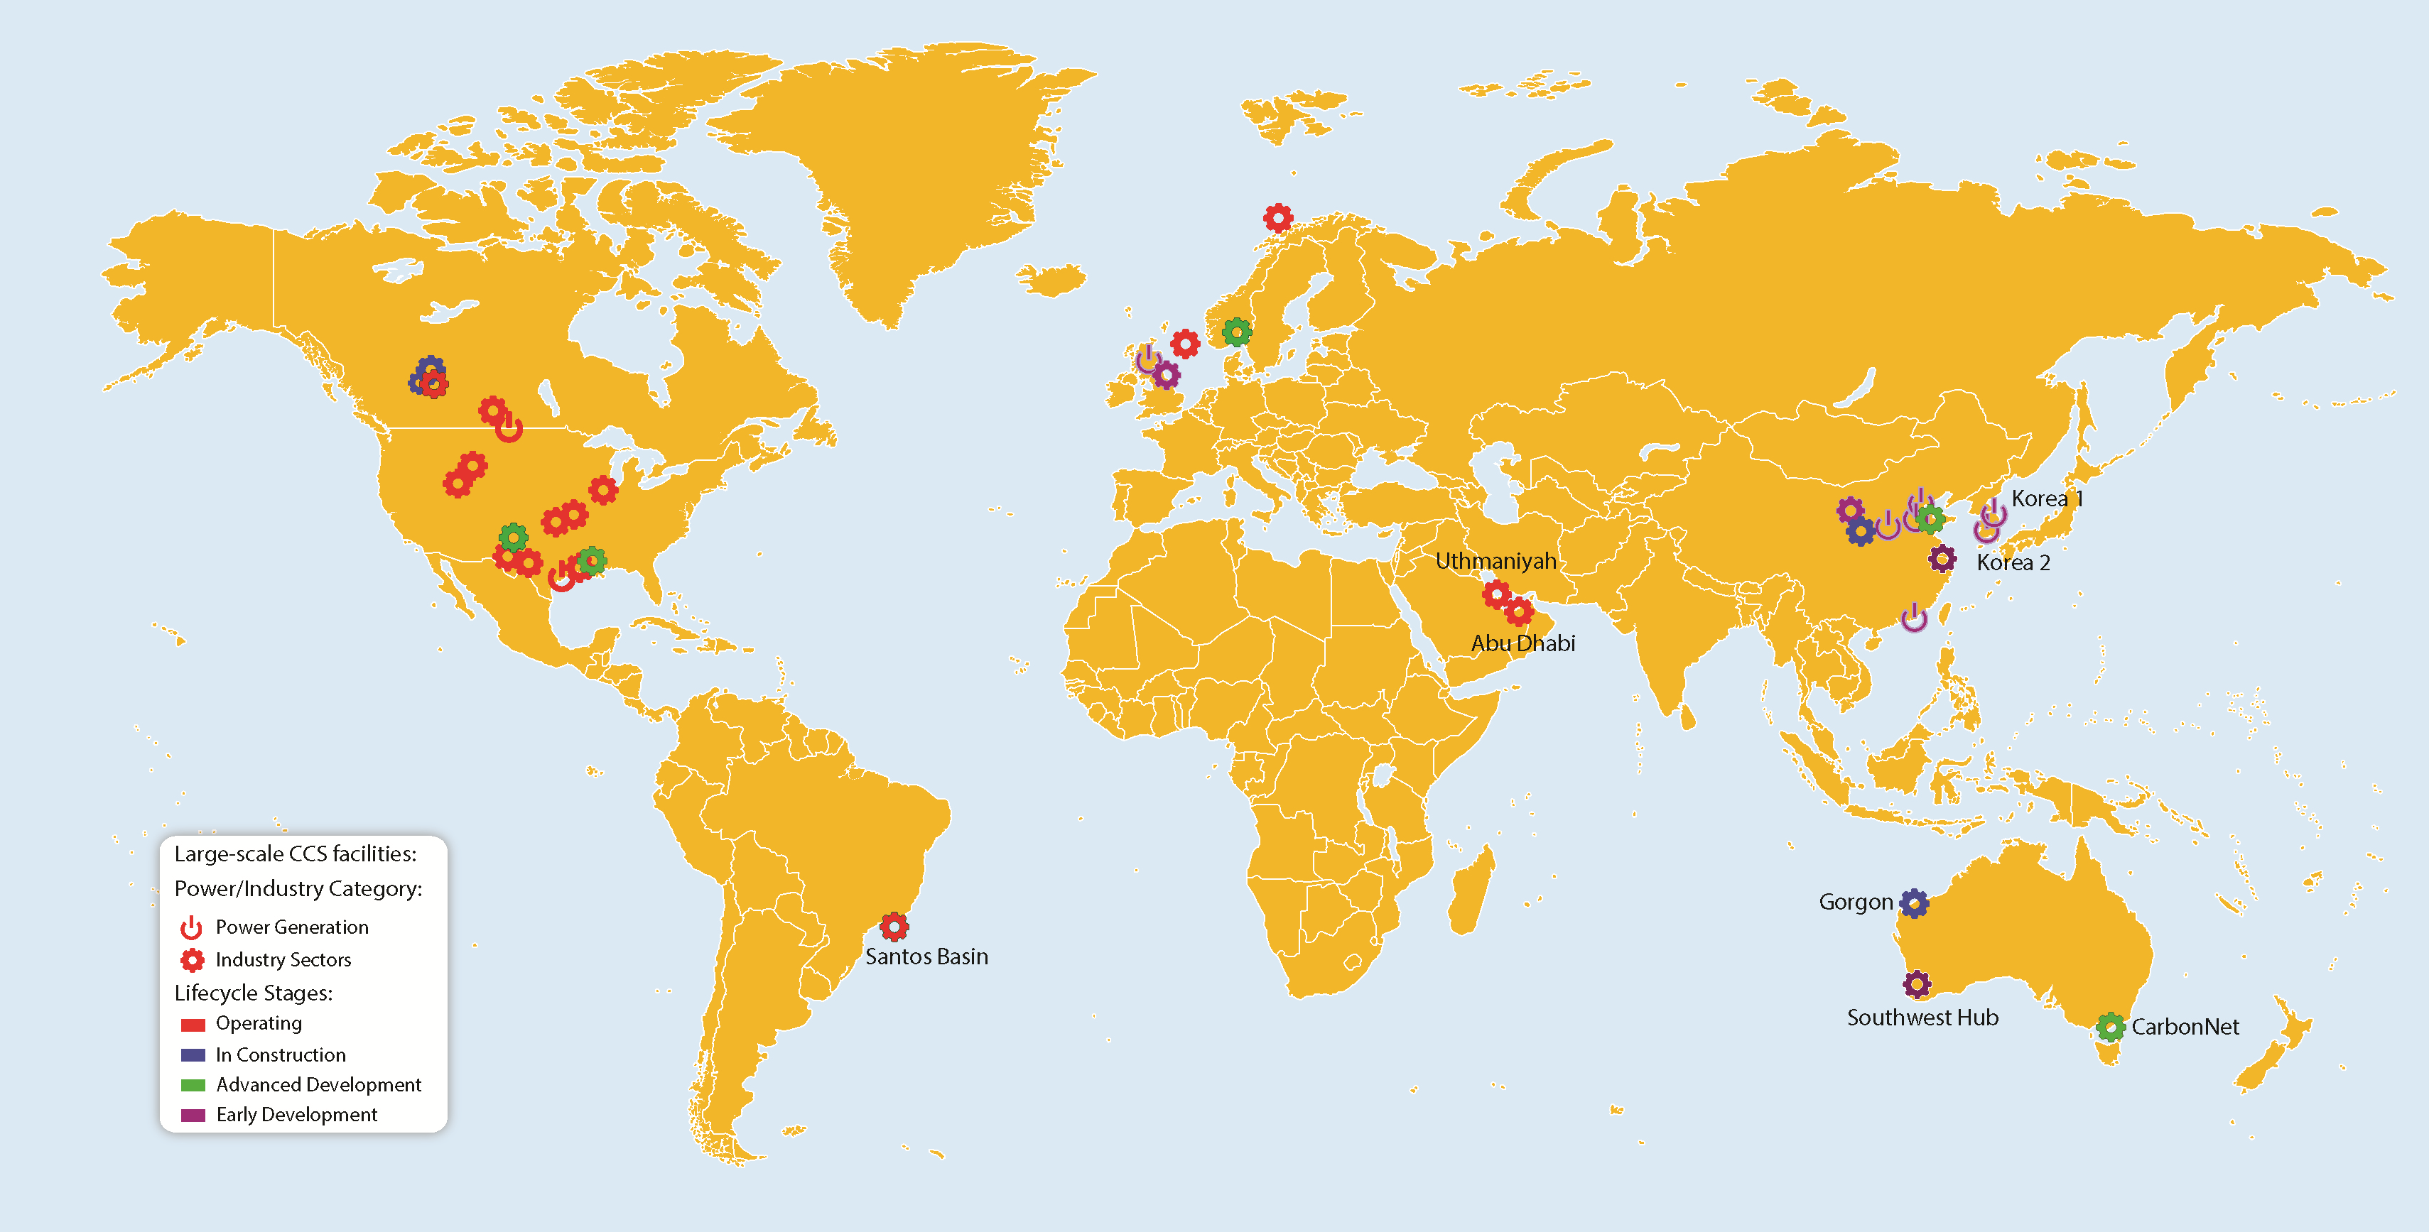
Global large-scale CCS facilities

Slide 4
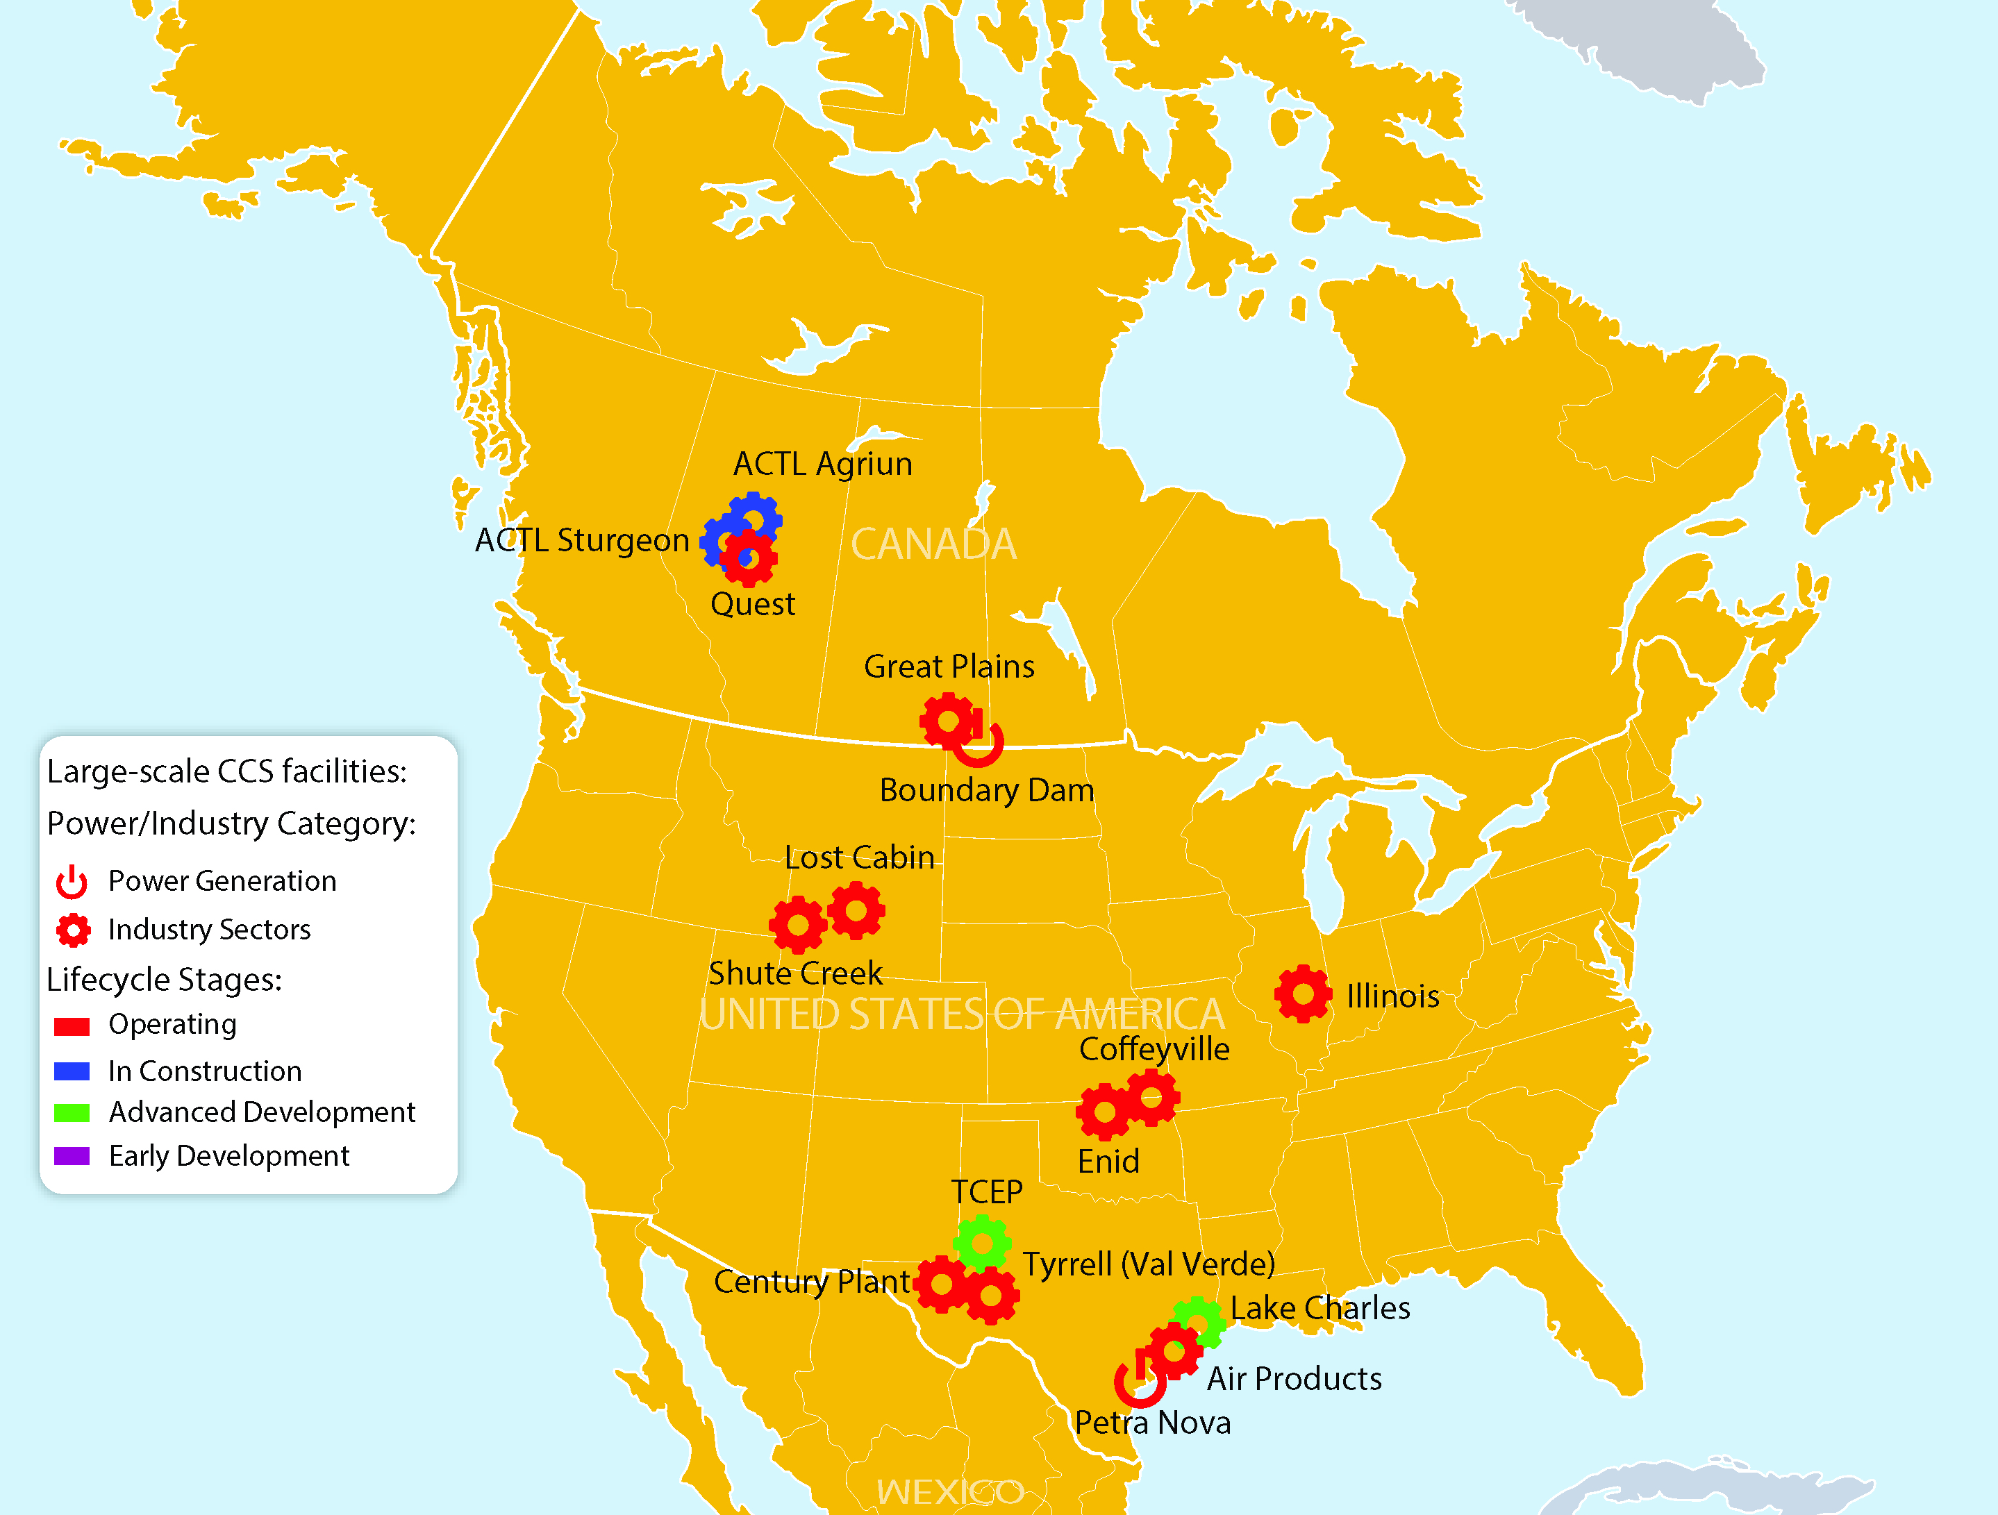
Large-scale CCS facilities in North America
Notes:
Terrell Natural Gas Processing Plant (formerly Val Verde Natural Gas Plants)
Enid Fertilizer
Shute Creek Gas Processing Facility
Great Plains Synfuel Plant and Weyburn-Midale
Century Plant
Air Products Steam Methane Reformer EOR
Coffeyville Gasification Plant
Lost Cabin Gas Plant
Boundary Dam Carbon Capture and Storage
Quest
Petra Nova Carbon Capture
Illinois Industrial Carbon Capture and Storage
Alberta Carbon Trunk Line ("ACTL") with Agrium CO2 Stream
Alberta Carbon Trunk Line ("ACTL") with North West Sturgeon Refinery CO2 Stream
Lake Charles Methanol
Texas Clean Energy Project

Slide 5
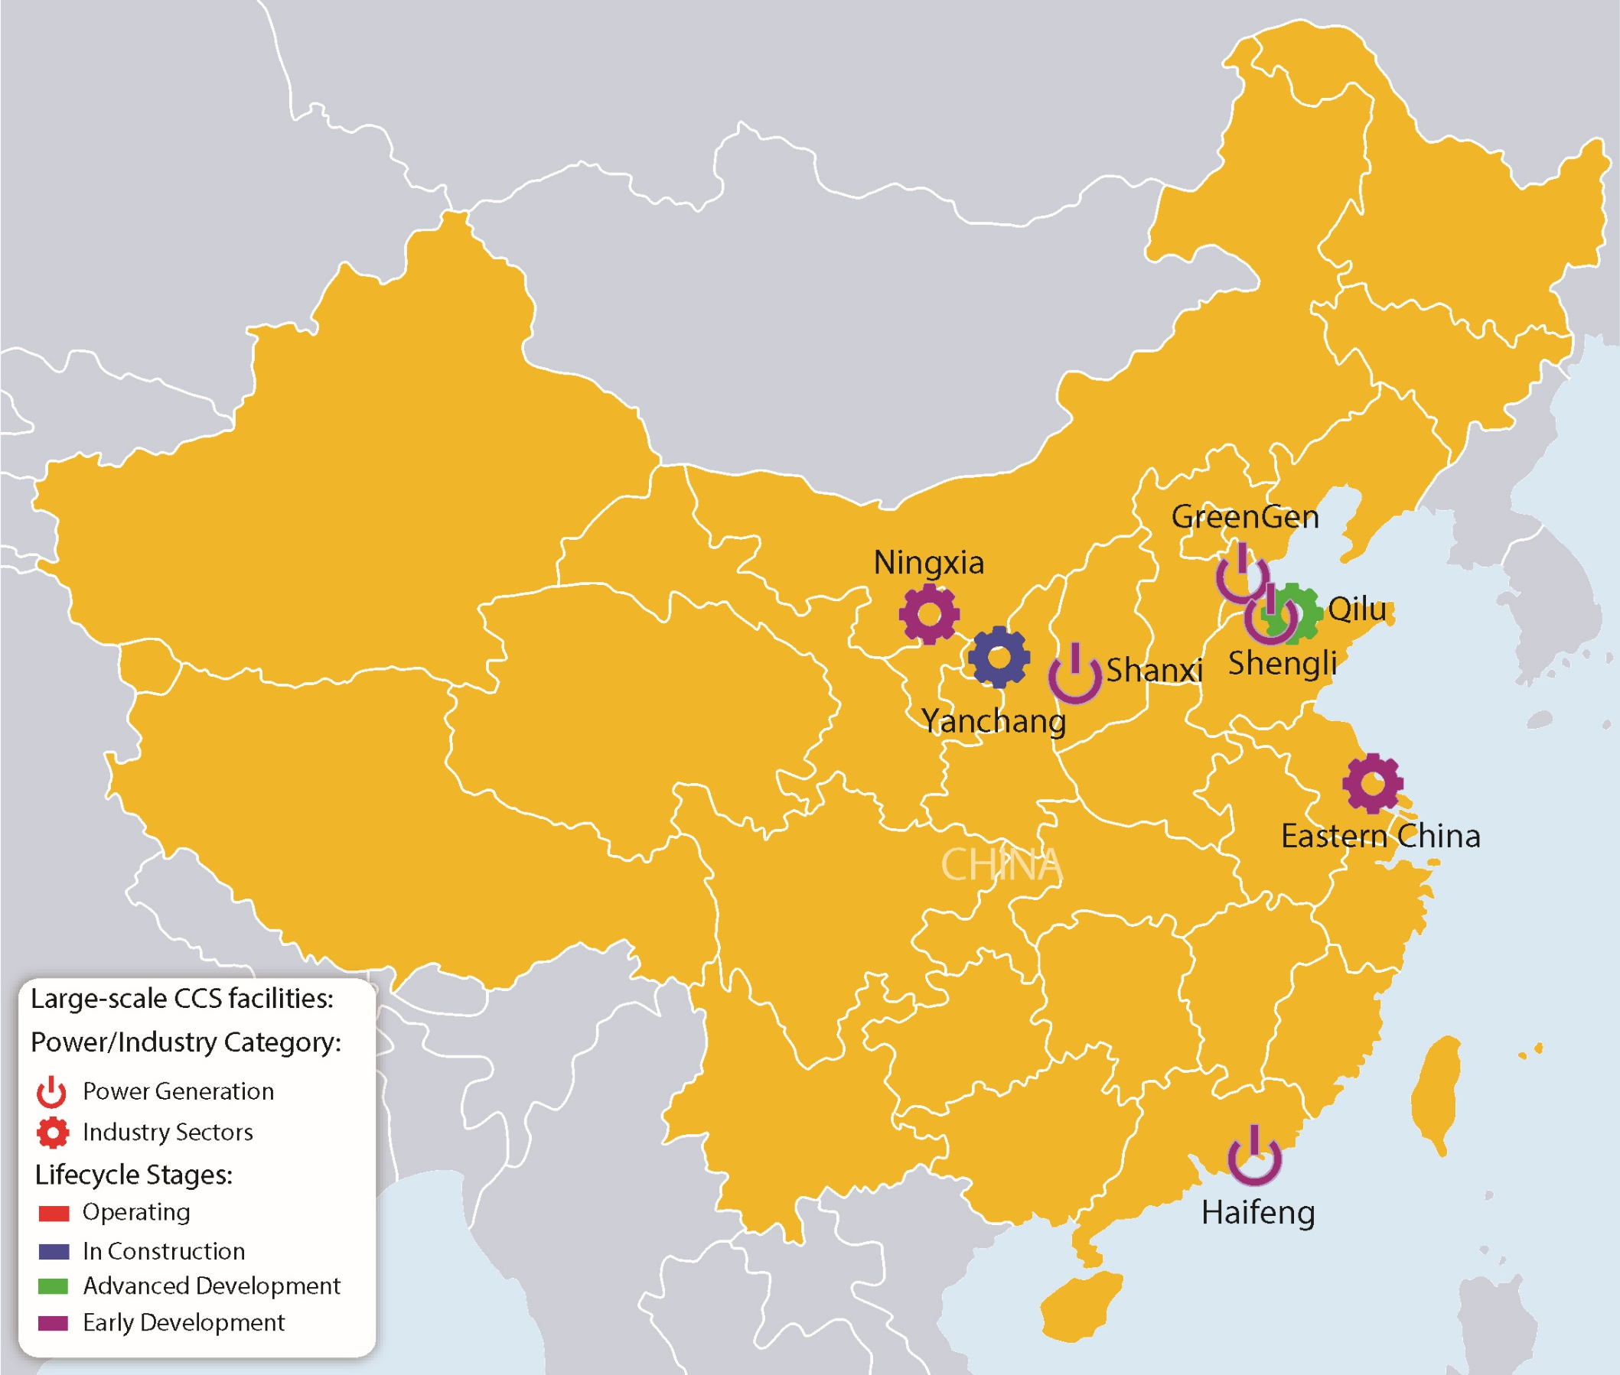
Large-scale CCS facilities in China
Notes:
Yanchang Integrated Carbon Capture and Storage Demonstration
Sinopec Qilu Petrochemical CCS
Sinopec Eastern China CCS
Sinopec Shengli Power Plant CCS
China Resources Power (Haifeng) Integrated Carbon Capture and Sequestration Demonstration
Huaneng GreenGen IGCC Large-scale System (Phase 3)
Shanxi International Energy Group CCUS
Shenhua Ningxia CTL

Slide 6
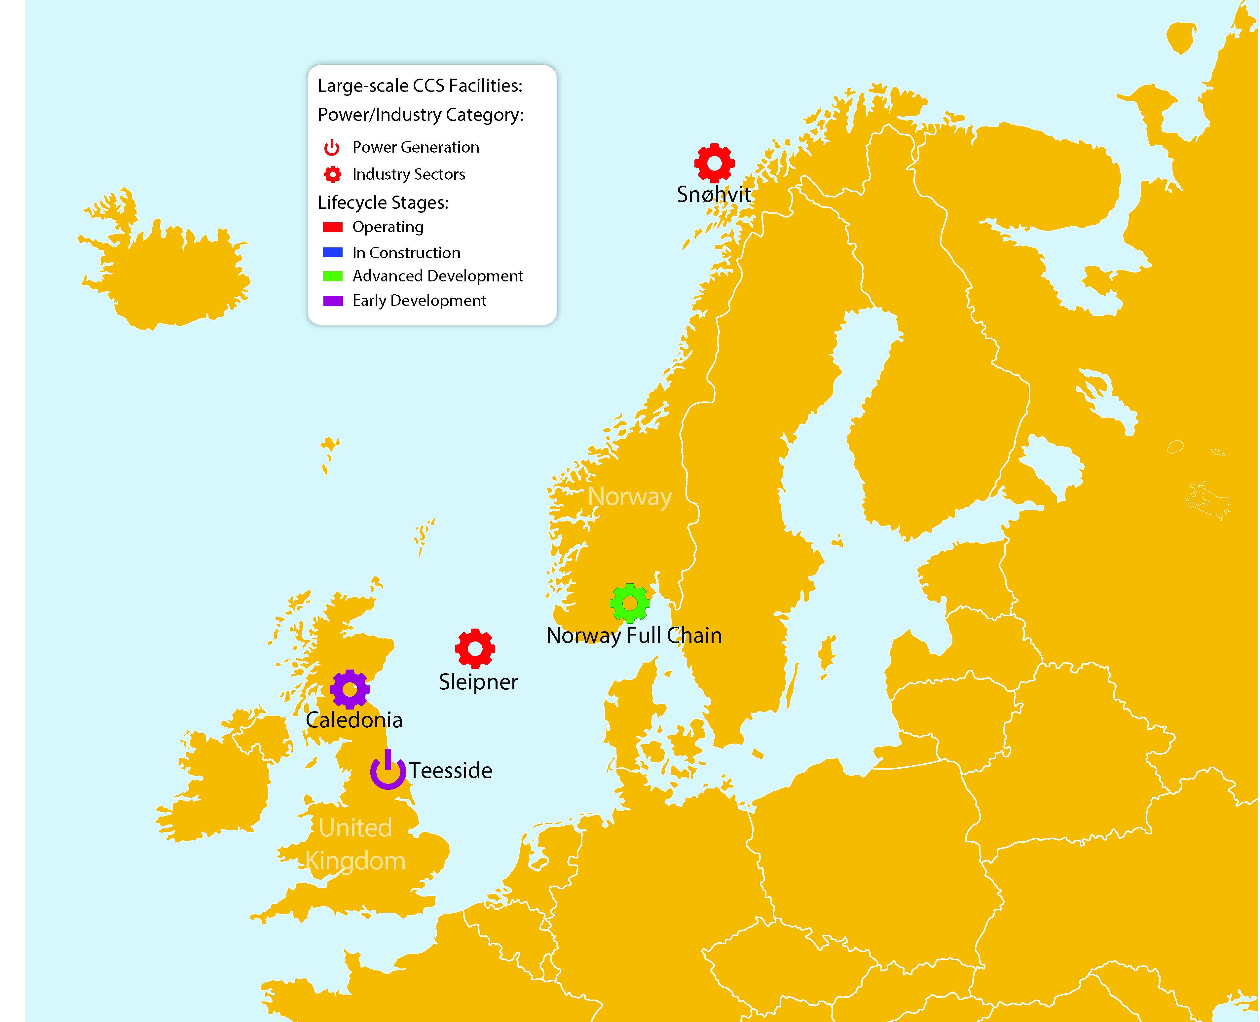
Large-scale CCS facilities in Europe
Notes:
Sleipner CO2 Storage
Snøhvit CO2 Storage
Norway Full Chain CCS
Teesside Collective
Caledonia Clean Energy

Slide 7
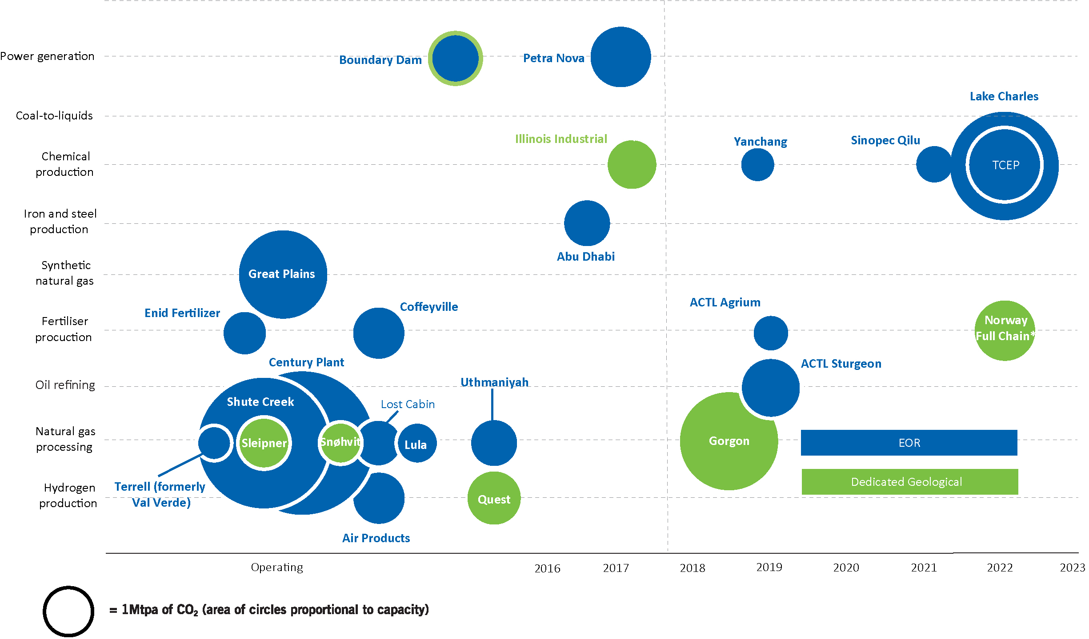
Large-scale CCS facilities by industry
# Facilities in the Operating, In construction and Advanced development stages
* Assessing CCS possibilities from ammonia production, from cement production and from waste-to-energy sources

Slide 8

International Policy – UNFCCC and IPCC
UNFCCC
  COP-23: CCS maintained high profile
  Prior to meeting: focus on ensuring CCS not disadvantaged in the “rulebook” for the Paris Agreement.
  Formal decision on rulebook expected at COP-24
  Market Mechanisms
  Green Climate Fund
IPCC – 1.5C report – ensuring CCS importance is reflected
“Powering Past Coal” – momentum is growing
  Industrial CCS more important than power in some countries

Slide 9
CCS Policy Measures – Deployed and Proposed
Policy Type | Where Proposed/Deployed
Cap and Trade | EU, China, Canada, S. Korea, USA, Japan, Switzerland
Carbon and Environmental Taxes | Canada, Denmark, Norway, Japan, Mexico, Netherlands, Sweden, France, UK
Power sector emissions performance standards | Canada, UK, USA
Enabling legislation | EU, Australia, etc.
Price subsidies | UK
Grants/subsidies | Australia, Canada, EU, Netherlands, Norway, UK, USA, UAE
Institutional strengthening | UK, Indonesia, Malaysia, China, USA, etc.

Slide 10
CCS Policy Measures – Deployed and Proposed
Policy Type | Where Proposed/Deployed
Tax relief (credits/reductions) | USA
Loans (low cost, guarantees) | USA, Green Investment Bank
Offsets | UNFCCC, Canada (Alberta)
Power purchase agreements | USA
RD&D funding | Australia, Canada, China, EU, Netherlands, Norway, S. Korea, UK, USA, UAE
State assumption of liability/trust funds | USA
Strategic planning/key policy statements | USA, China, EC, Norway, S. Korea

Slide 11
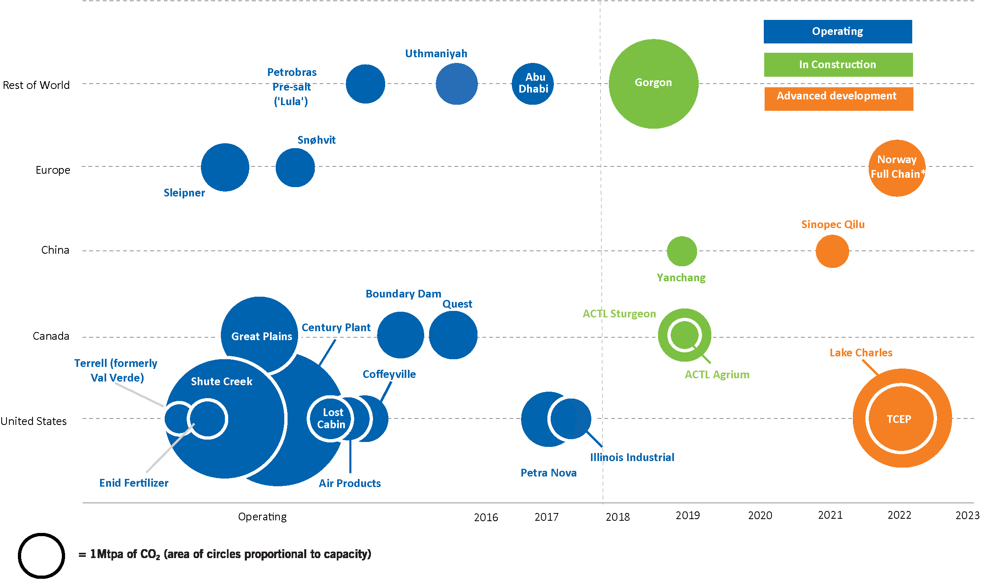
Policy measures that work
Required for permit
Steep carbon tax
Development Grant
EOR
EOR w tax incentive
Loan Guarantee
EOR w tax incentive
Capital Grant

Slide 12
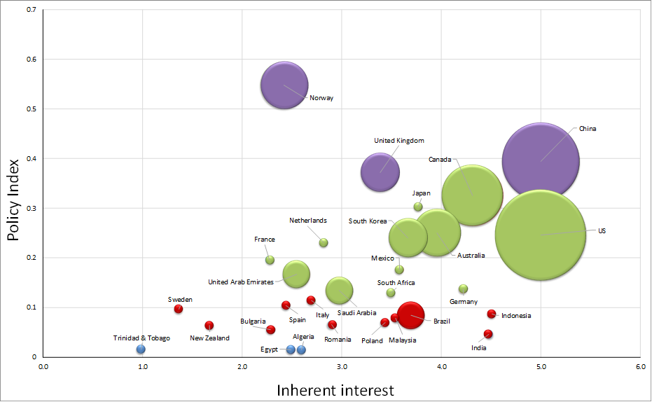
Norway, China, UK lead 2017 CCS Policy Indicator
Notes:
The Institute’s CCS Policy Indicator captures the status of CCS policy around the world. The Policy Indicator plots the overall strength of a government’s policy stance on CCS in the form of a “Policy Index”, as well as its “Inherent interest” in CCS, which reflects the country’s relative propensity towards fossil fuel production and consumption.

Slide 13
EMEA: Norway – Top Tier
Lower
Lower Mid
Upper Mid
Upper
Committed to being carbon neutral by 2050, 40% reduction by 2030
Public reporting against carbon budgets
Steep tax on oil/gas production in North Sea (1996)
Grant funding for feasibility and design of Full Chain CCS Project (cement, ammonia, WTE)
Seeking to be the “storage hub of Europe”
Consistent policy narrative on need for CCS to achieve climate goals
Notes:
Sleipner CO2 Storage
Snøhvit CO2 Storage
Norway Full Chain CCS
Teesside Collective
Caledonia Clean Energy

Slide 14
EMEA: United Kingdom – Top Tier
Lower
Lower Mid
Upper Mid
Upper
In 2015 withdrew large-scale project funding
2017 UK Energy Policy, the Clean Growth Strategy, identifies CCS as critical to reduce emissions and decarbonize heavy industries
Strong institutional frameworks and supporting climate policies
Carbon price floor
European Emissions Trading Scheme
Committed to “Powering Past Coal”
Notes:
Sleipner CO2 Storage
Snøhvit CO2 Storage
Norway Full Chain CCS
Teesside Collective
Caledonia Clean Energy

Slide 15
EMEA: The Netherlands – Upper Mid Tier
Lower
Lower Mid
Upper Mid
Upper
Goal of 49% reduction in CO2 emissions by 2030 – 20% from CCS
4 billion euros per year to boost new CO2 reduction technologies
In 2017 withdrew project funding for ROAD project
Port of Rotterdam “Backbone CCS” project – 20% of country’s CO2 emissions
European Emissions Trading Scheme
Notes:
Sleipner CO2 Storage
Snøhvit CO2 Storage
Norway Full Chain CCS
Teesside Collective
Caledonia Clean Energy

Slide 16
EMEA: United Arab Emirates – Upper Mid Tier
Lower
Lower Mid
Upper Mid
Upper
Grant funding provided for El Reyadah (Emirates Steel CCS)
Green Economy strategic plan includes CCS as one of six elements
ADNOC recently committed to five more CCS-EOR projects
Notes:
Sleipner CO2 Storage
Snøhvit CO2 Storage
Norway Full Chain CCS
Teesside Collective
Caledonia Clean Energy

Slide 17
Americas: Canada – Upper Mid Tier
Lower
Lower Mid
Upper Mid
Upper
Large project grant funding for Quest, Boundary Dam, ACTL
Federal carbon price floor of $50 per tonne by 2022
Committed to “Powering Past Coal”
Ambitious climate goals by federal government and provinces
Consistent policy narrative on need for CCS to achieve climate goals
Notes:
Sleipner CO2 Storage
Snøhvit CO2 Storage
Norway Full Chain CCS
Teesside Collective
Caledonia Clean Energy

Slide 18
Americas: United States – Upper Mid Tier
Lower
Lower Mid
Upper Mid
Upper
Dropped in ranking due to policy changes from Trump Administration
Clean Power Plan, setting emissions limits on coal plants, has been suspended
US has signaled intent to withdraw from the Paris Accord
Large-scale project funding mostly exhausted
Tax credits for EOR and storage
Energy Secretary support for EOR
Government loan guarantees
Notes:
Sleipner CO2 Storage
Snøhvit CO2 Storage
Norway Full Chain CCS
Teesside Collective
Caledonia Clean Energy

Slide 19
Americas: Mexico – Upper Mid Tier
Lower
Lower Mid
Upper Mid
Upper
Support for CCS in key policy statements
Carbon tax on fossil fuels
Ambitious emission reduction targets
Government funding for and involvement in capture and storage pilot projects
Notes:
Sleipner CO2 Storage
Snøhvit CO2 Storage
Norway Full Chain CCS
Teesside Collective
Caledonia Clean Energy

Slide 20
Asia-Pacific: China – Upper Tier
Lower
Lower Mid
Upper Mid
Upper
Commitments to ambitious carbon reductions
Yanchang Petroleum CCS under construction
Seven large-scale CCS projects in planning
ETS scheme in advanced planning
Notes:
Sleipner CO2 Storage
Snøhvit CO2 Storage
Norway Full Chain CCS
Teesside Collective
Caledonia Clean Energy

Slide 21
Asia-Pacific: Japan – Upper Tier
Lower
Lower Mid
Upper Mid
Upper
Comprehensive CCS policy/ regulatory framework in place
Robust research programs by METI and MoE
Long-term liability addressed in regulations
Supporting CCS in developing countries in Asia
Notes:
Sleipner CO2 Storage
Snøhvit CO2 Storage
Norway Full Chain CCS
Teesside Collective
Caledonia Clean Energy

Slide 22
Asia-Pacific: Australia – Upper Mid Tier
Lower
Lower Mid
Upper Mid
Upper
Clean Energy Target policy may enable subsidies for CCS-equipped power plants
Substantial R&D funding
Long-term liability for CO2 at Gorgon assumed by Western Australia state government
$2.5 billion emissions reduction fund
Notes:
Sleipner CO2 Storage
Snøhvit CO2 Storage
Norway Full Chain CCS
Teesside Collective
Caledonia Clean Energy

Slide 23
Required scale-up is a monumental task
The Last 25 Years
The Next 25 Years
3,800 Mtpa of CO₂ captured and stored by 2040 (IEA 2DS)**
37 large-scale CCS facilities - combined CO2 capture capacity of approximately 69 Mtpa*:
21 facilities in operation or construction (~37 Mtpa)
5 facilities in advanced development (~13 Mtpa)
11 facilities in earlier stages of development (~19 Mtpa)
37 Mtpa
Non-OECD
OECD
*Mtpa = million tonnes per annum
**Source: International Energy Agency (2017), Energy Technology Perspectives 2017, OECD/IEA, Paris
Note: 2040 IEA 2DS data includes ~0.6 Mtpa “negative emissions” from BECCS

Slide 24
CCS – The key to the new energy economy
Time to move on from narrow view of CCS as only a coal fired generation technology. It’s much bigger than this.
Production of clean chemicals, plastics, steel, fertilisers, cement, etc requires CCS
Hydrogen production and use vital addition to energy system; coal gasification and SMR both with CCS key to cost effective delivery
New opportunities for climate friendly industrial hubs centred on using CCS for clean production of essential products and fuels
Opportunity to re-fuel generators with hydrogen
Policy essential to realise these opportunities
Reserves to production ratio: ~75 years

Slide 25
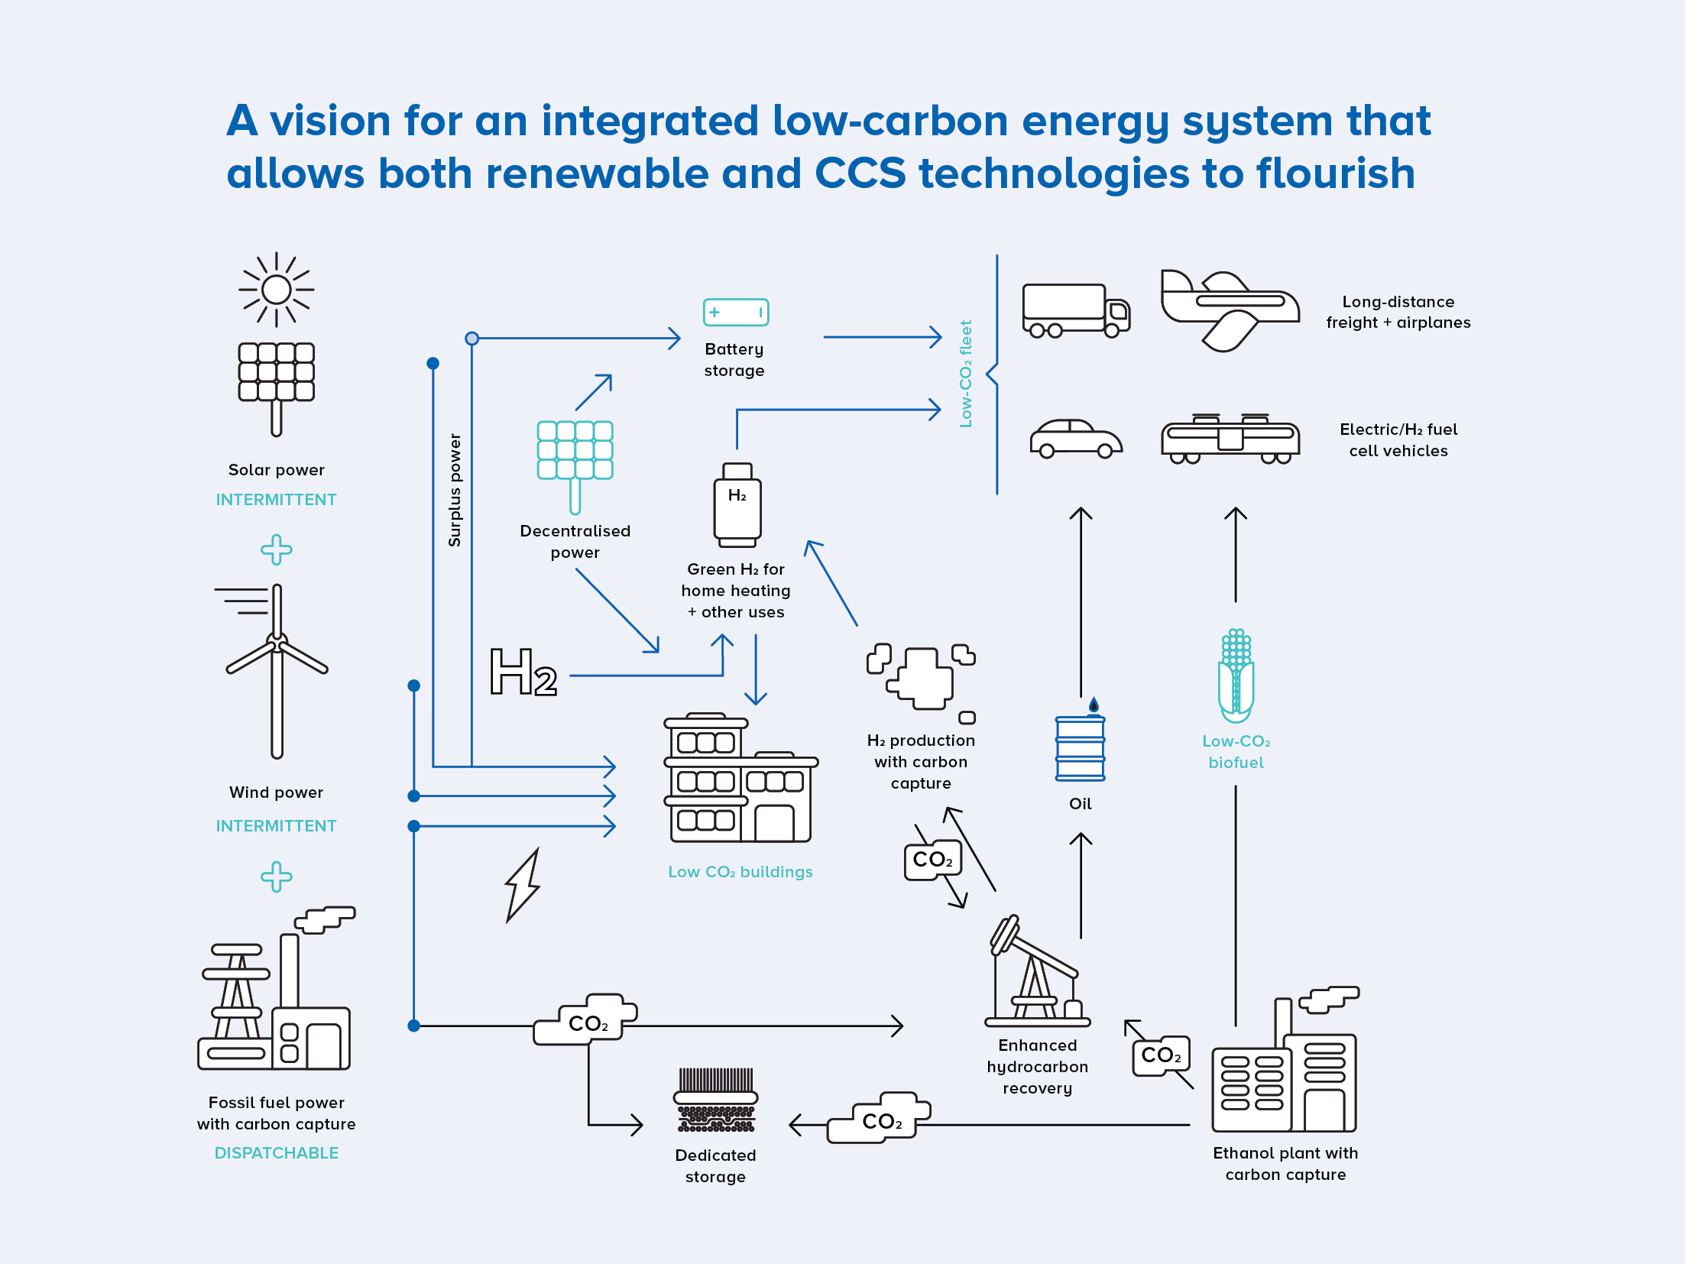

Slide 26
