Slide 1
CCS Technology Status
Strategies to Advance Carbon Capture
CMTC Workshop
March 15, 2018

Slide 2
Classifying CO₂ Sources
Category | % CO₂ (vol) | Example
High Pressure | varies | Gas Wells (e.g., Sleipner) Synthesis Gas (e.g., IGCC)
High Purity | 90-100% | Ethanol Plants Oxy-Combustion Exhaust
Dilute | 10-20% | Coal-Fired Power Plants Cement Plants Cracker Exhaust
Very Dilute | 3-7% | Natural Gas Boilers Gas Turbines
Extremely Dilute | 0.04 – 1% | Ambient Air Submarines/ Space Craft

Slide 3
Capture Technology

Slide 4
Pros/Cons for Amines
Pros
Commercially proven
Closing gap with minimum work
Scales well
Cons
Temperamental about impurities
Requires steam (not plug and play)
Limits flexibility

Slide 5
Reseach Focus
Main focus to date has been to reduce the energy penalty
The following are becoming increasingly important:
Flexibility
Storage
Low capital costs

Slide 6
Market Challenges
Power
Lowering capacity factors for base load – disadvantages high capital cost systems
Premium for flexibility
Load following
Turndown
Storage
Industrial
Lack of steam

Slide 7
New Capture Process Pathways
Post-combustion Capture
Adsorption
Membranes
Cryogenics
Fuel Cells
New Power Cycles
Gasification with pre-combustion
Oxy-combustion
Chemical looping

Slide 8
Gasification
At one point, anointed the future of clean coal and CCS
High efficiencies
Criteria pollutant clean-up
CCS
Issues
Availability
High capital costs
Biomass Integrated Gasification (BIG)
Still prominent in literature
Tougher than IGCC with coal
Feeding biomass
Moisture

Slide 9
Allam Cycle
Net Power, CB&I, Exelon, Toshiba
50 MW_{th} prototype under construction near Houston
Broke ground March 9th, 2016
Turbine inlet: 300 bar, Turbine outlet: 30 bar, ~97% recycle

Slide 10
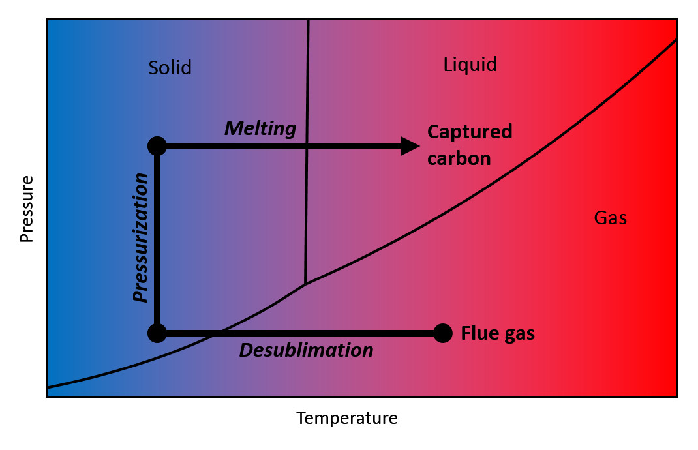
Cryogenic Carbon Capture
Post-combustion
SES Innovation
Prof. Larry Baxter
Brigham Young Univ.
Demonstrated at 1 tpd at coal plants
Features
No steam required (plug and play)
Multipollutant capture
Energy storage

Slide 11
Geologic Storage

Slide 12
Geologic Storage Status
Commercial Analogues
Enhanced Oil Recovery (EOR) – since 1972
Acid Gas Injection – since 1989
Natural Gas Storage – since 1915
Commercial Operations: 6 projects at megaton/yr scale
Subsurface Uncertainty
Capacity
Long-term Integrity
Induced Siesmicity
Other Issues
Regulatory Framework
Long-term Liability
Public Acceptance
Passive vs. Engineered Systems

Slide 13
Utilization

Slide 14
Utilization
Use | Market Size | Permanence | Life-Cycle Energy | Comments
EOR | 0 | + | 0 | Stepping Stone
Mineralization | + | + | Theory: + Reality: - | Opportunities in Cement
Chemicals, etc. | - | - | - | Niche Applications
Fuels | + | - | - | Costly

Slide 15
Negative Emissions

Slide 16
CO₂ Removal Options
BECCS: Bioenergy with carbon capture and storage
DAC: Direct air capture of CO₂ from ambient air by engineered chemical reactions
EW: Enhanced weathering of minerals, where natural weathering to remove CO₂ from the atmosphere is accelerated and the products stored in soils, or buried in land or deep ocean
AR: Afforestation and reforestation to fix atmospheric carbon in biomass and soils
Ocean: Manipulation of carbon uptake by the ocean, either biologically (that is, by fertilizing nutrient-limited areas) or chemically (that is, by enhancing alkalinity)
Agriculture: Altered agricultural practices, such as increased carbon storage in soils
Biochar: Converting biomass to recalcitrant biochar, for use as a soil amendment.
From Smith, et al., “Biophysical and economic limits to negative CO₂ emissions”, Nature Climate Change, 6, January (2016).

Slide 17
Negative Emissions
BECCS
Require carbon prices ~$100/tCO₂
Avoids paying the carbon price
Receives carbon credits for negative emissions
Major barrier – finding carbon neutral biomass
DAC
Require carbon prices ~$1000/tCO₂ or carbon-free power that is too cheap to meter

Slide 18
Role of Negative Emissions
Lower atmospheric CO₂ levels
Purpose: Meet an [arbitrary] stabilization target
Scale: 10s Gt CO₂/yr
Cost: > > today’s mitigation costs
Offsets
Purpose: Offset emissions that are very expensive to mitigate
Scale: Gts CO₂/yr
Cost: < marginal mitigation cost at any time

Slide 19
Scenarios

Slide 20
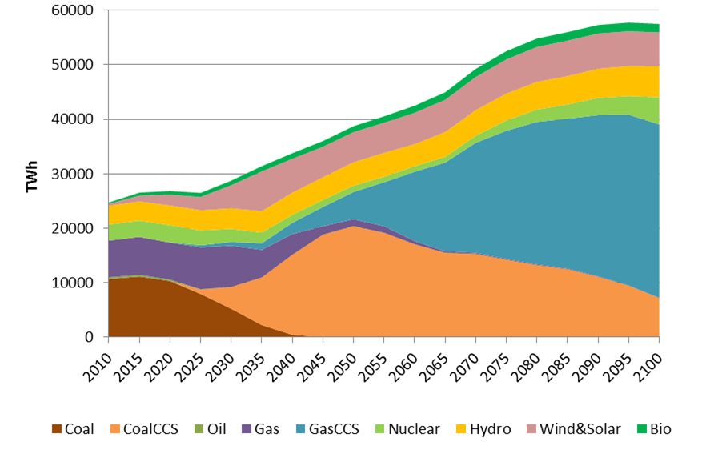
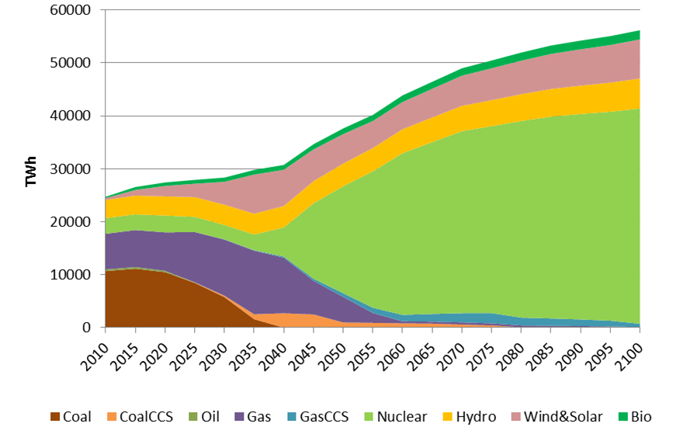
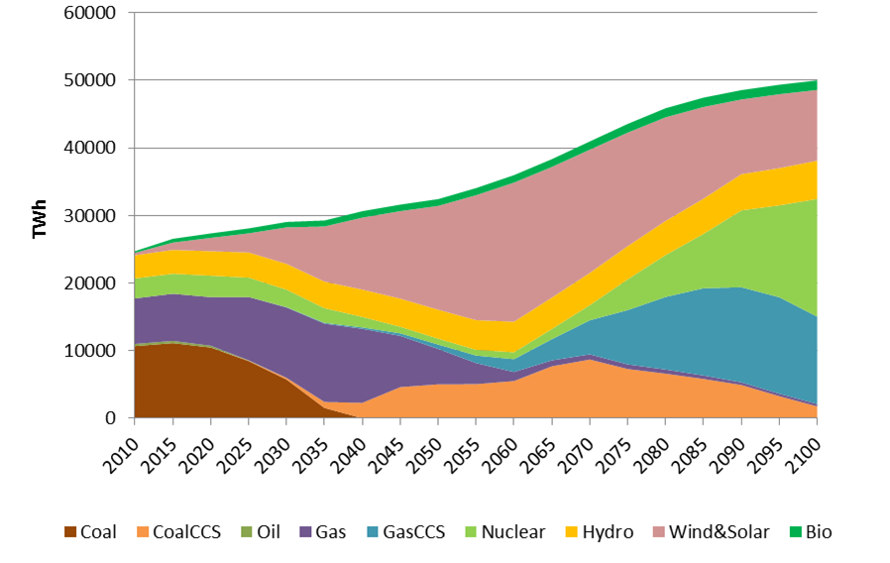
Global Results to 2100
Base
Cheap CCS
Cheap Nuclear
Cheaper Renewables

Slide 21
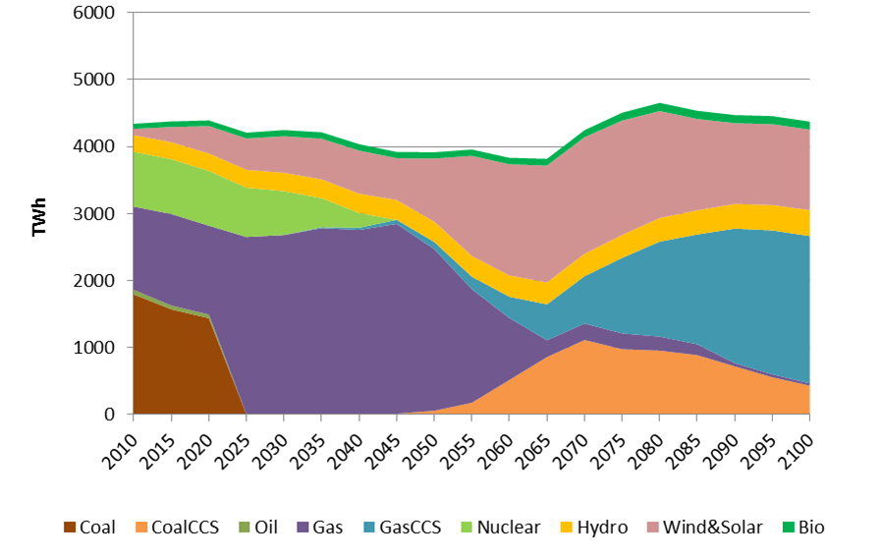
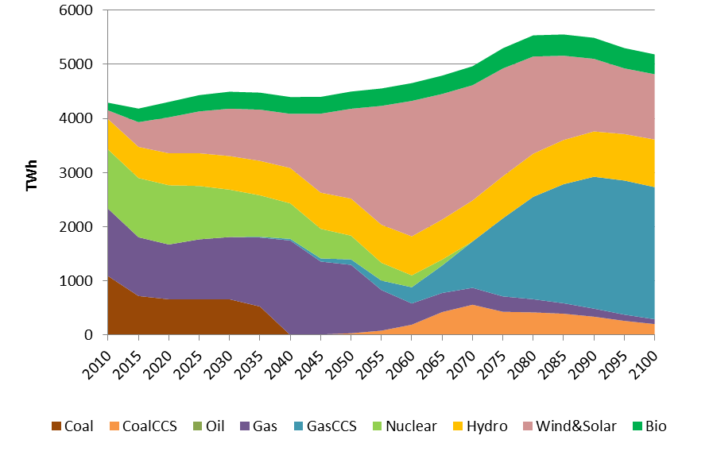
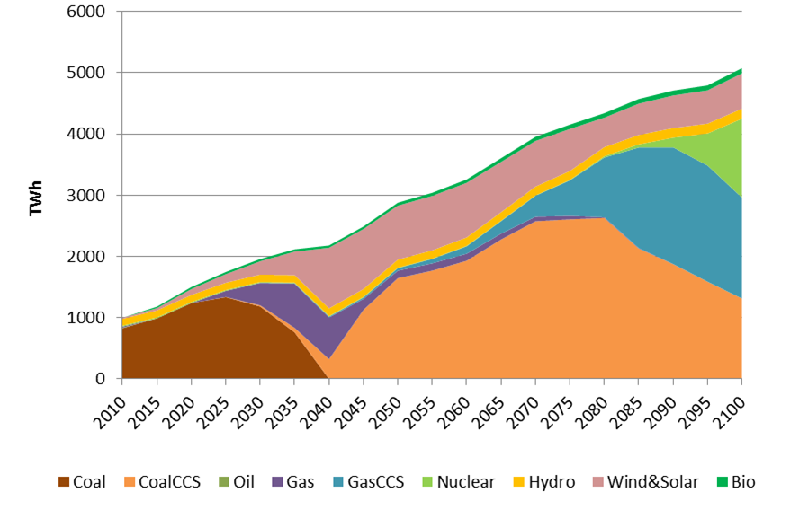
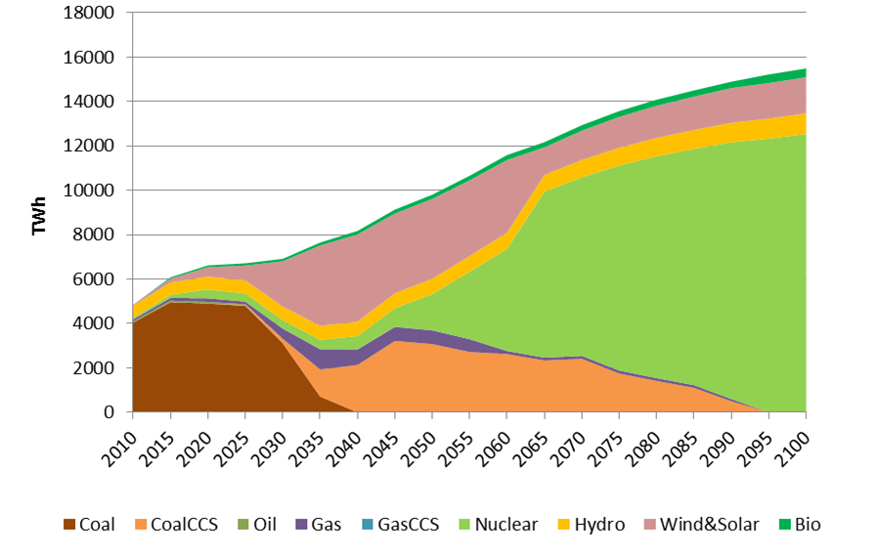
Major Regional Results to 2100
USA
EUR
China
India

Slide 22
Closing Thoughts
Carbon Dioxide Capture and Storage (CCS) is technically viable today and has significant scope for improvement.
While there is room to improve costs, it will always be cheaper to emit CO₂ to atmosphere than capture. Therefore, policy is required to make CCS economically viable.
A low carbon energy system will have significant differences from today’s energy systems. We need to develop innovative CCS technology that fits with tomorrow’s systems.
Utilization and negative emissions are hot topics in CCS today. We may need to pump the brakes a bit.

Slide 23
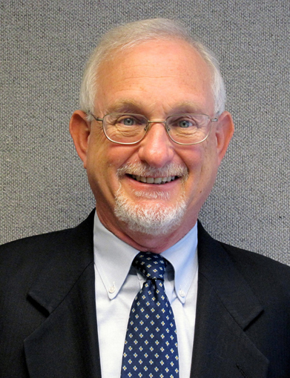
Contact Information
Howard Herzog
Senior Research Engineer
Massachusetts Institute of Technology (MIT)
Energy Initiative
Room E19-370L
Cambridge, MA 02139
Phone: 617-253-0688
E-mail: hjherzog@mit.edu
Web Site: sequestration.mit.edu

